Slide 1
Why does this song feel like that?
Exploring Music Moods Through Spotify Audio Features
By Aayushi Malhotra for CMSE 830

Slide 2
From Spotify Data to Music Moods
Cleaning the data
Creating mood groups
32,833 → 28,356 songs
Started with 32,833 rows and 23 columns.
Found 4,477 repeated track IDs.
Kept unique songs for feature analysis.
For genre comparisons, kept each song once per genre.
I used two Spotify audio features:
Valence: How positive a song sounds
Energy: How intense a song sounds
Using 0.5 as the cutoff, I created four approximate mood groups:
Positive + Energetic
Positive + Calm
Negative + Energetic
Negative + Calm

Slide 3
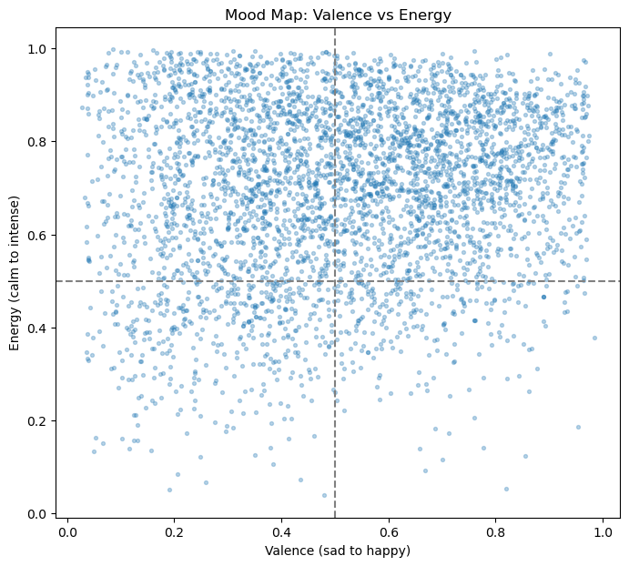

Slide 4
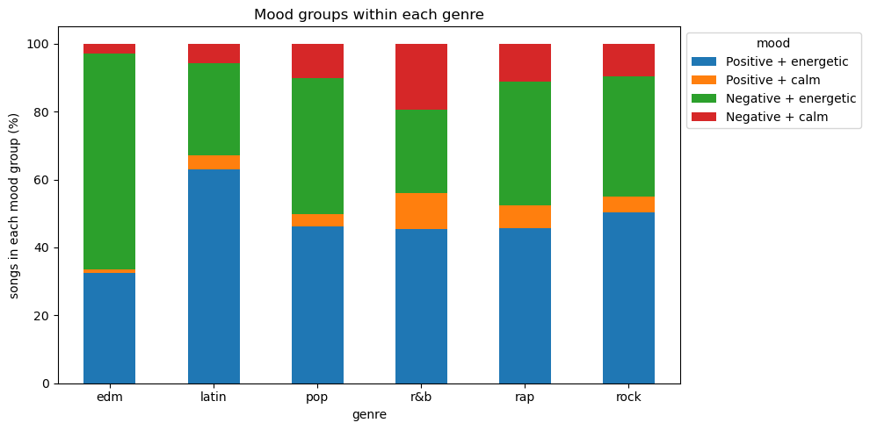
Does Genre Determine a Song’s Mood?
Three things I found:
Genre explains only about 10% of how a song feels, only EDM really stands apart.
Popularity has almost no link to how a song sounds.
Music got sadder after 2013 while energy stayed high.
So mood beats genre and popularity for how a song feels.

Slide 5
Find Your Vibe!
An interactive way to explore songs by how they feel, not just by genre or popularity.
Three main features
01 - Find your vibe. Pick a mood, genre and popularity and explore the matches on a mood map.
02 - See how mood changed over time. Music got sadder after 2013 but stayed just as energetic.
03 - Find similar songs. Pick any song and get the closest matches by how they actually sound, across genres.

Slide 6
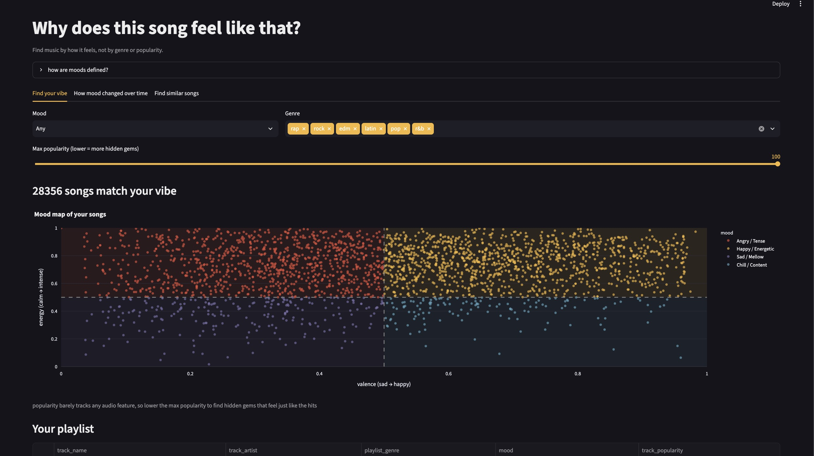

Slide 7
Limitations & What’s Next?
Limitations
Next Steps
Mood isn’t directly measured
Mood groups are based on valence and energy, not actual listener emotions.
Genres aren’t official labels
Songs are grouped using the playlists they appear in.
Dataset limitations
The dataset doesn’t represent every song on Spotify.
Add lyrics and emotion analysis
Compare how a song sounds vs how its lyrics read.
Cluster songs into vibes
Group songs automatically instead of fixed cutoffs.
Deploy the app
Put it online so anyone can try it.
GitHub: github.com/aayushimalhotra3/cmse830-midterm-project

Slide 8
Thank You!

